Slide 1
CTE field trip Pasadena
ART CENTER COLLEGE OF DESIGN and THE NORTON SIMON MUSEUM of ART
by Tom Lynn

Slide 2
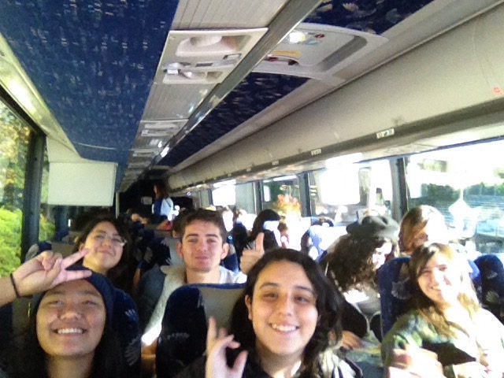
Cte field trip
CTE Visual Art students from Chula Vista High School/SCPA embark on an epic educational field trip to Pasadena.

Slide 3
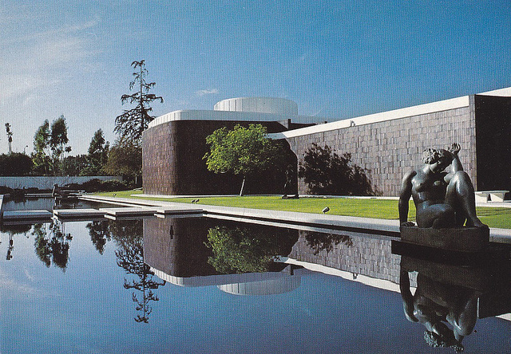
Cte field trip to Pasadena
Norton Simon Museum of Art
Art Center College of Design

Slide 4
cte field trip Norton simon
Docents greet CTE students.
Students are ready to explore the museum.

Slide 5
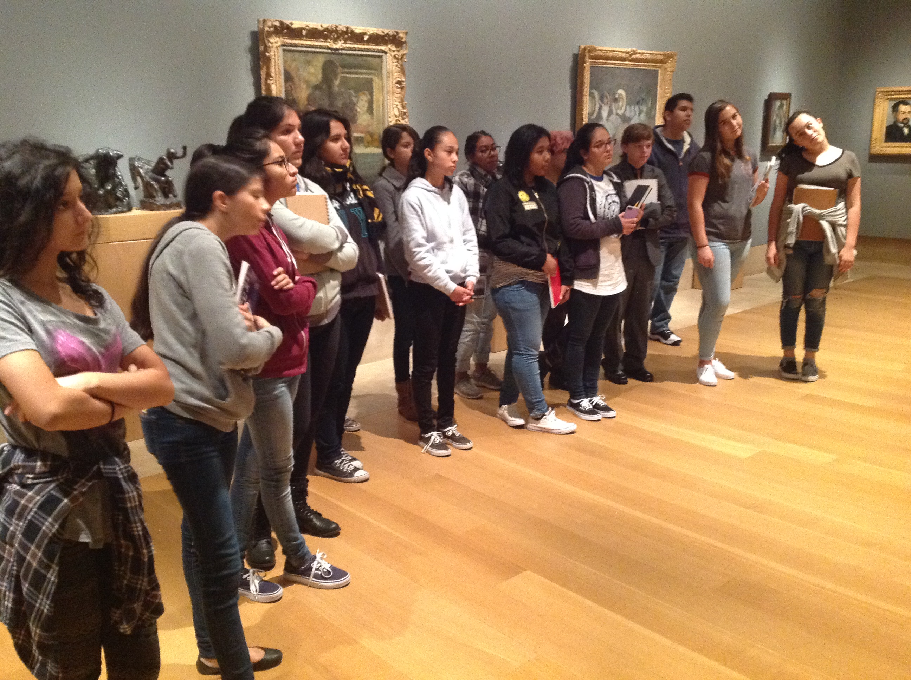
CTE field trip
Docents provide educational tours throughout the museum. The Norton Simon is one of the best museums in the industry for viewing world famous artworks.

Slide 6
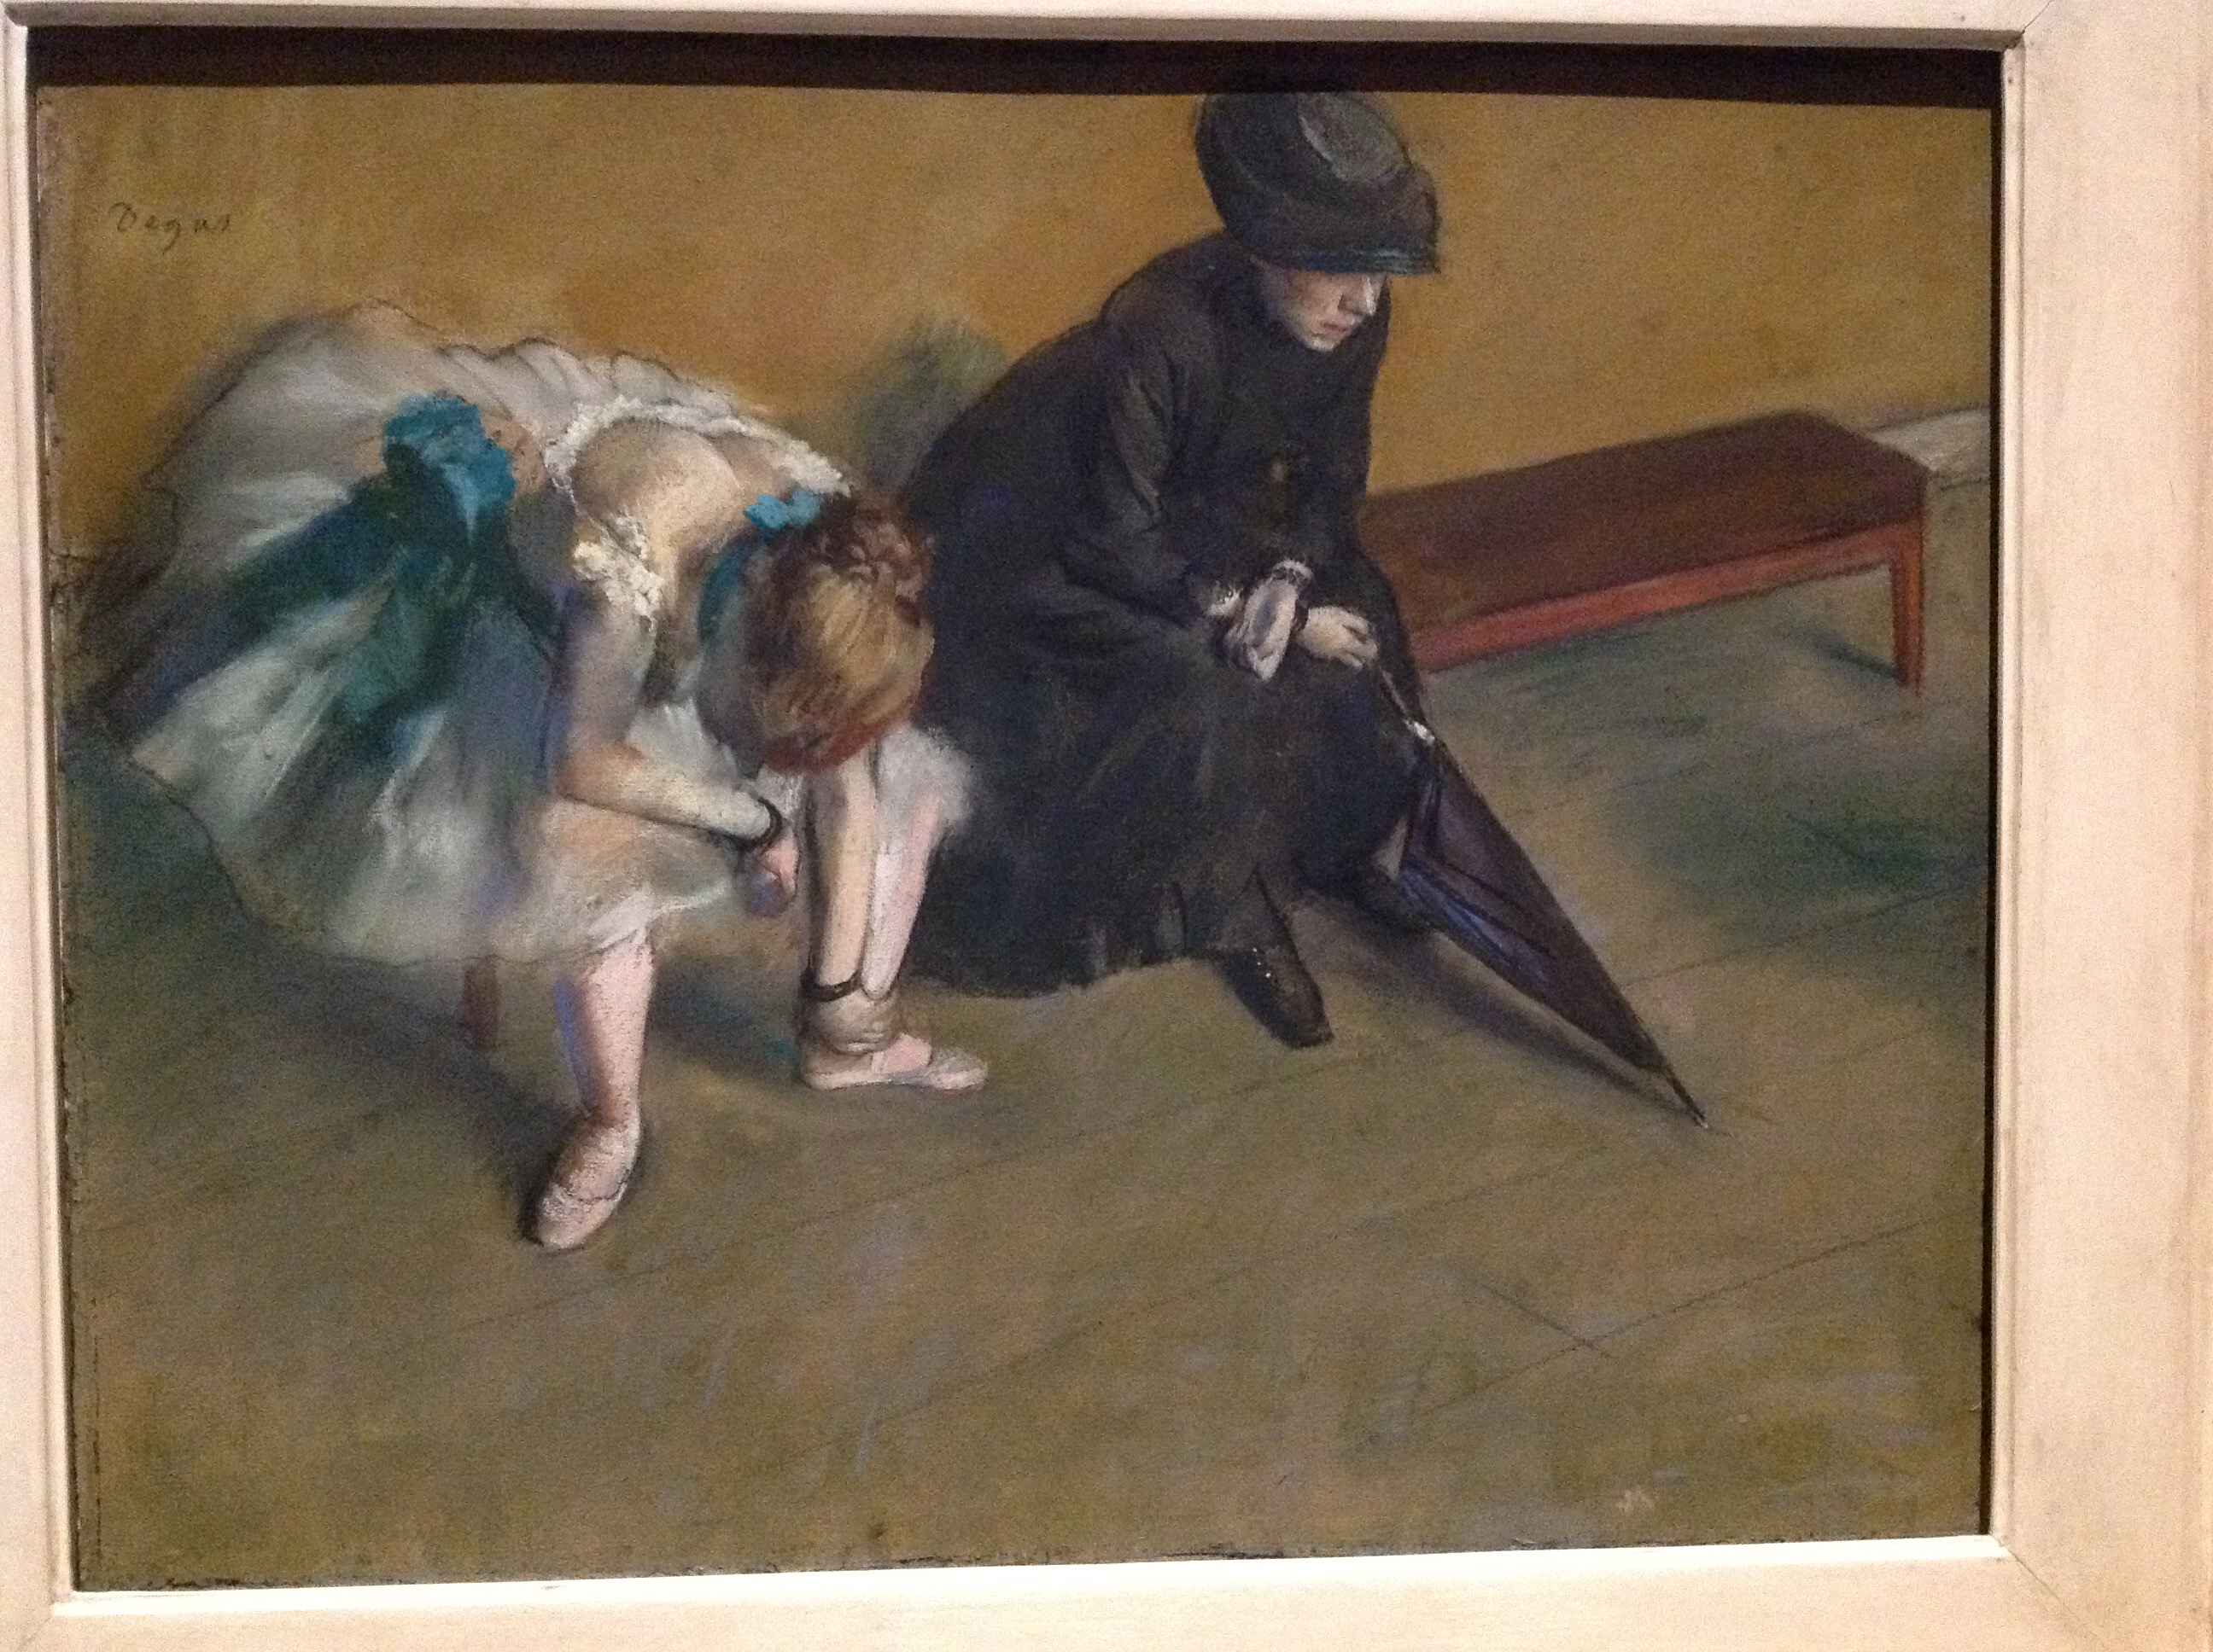
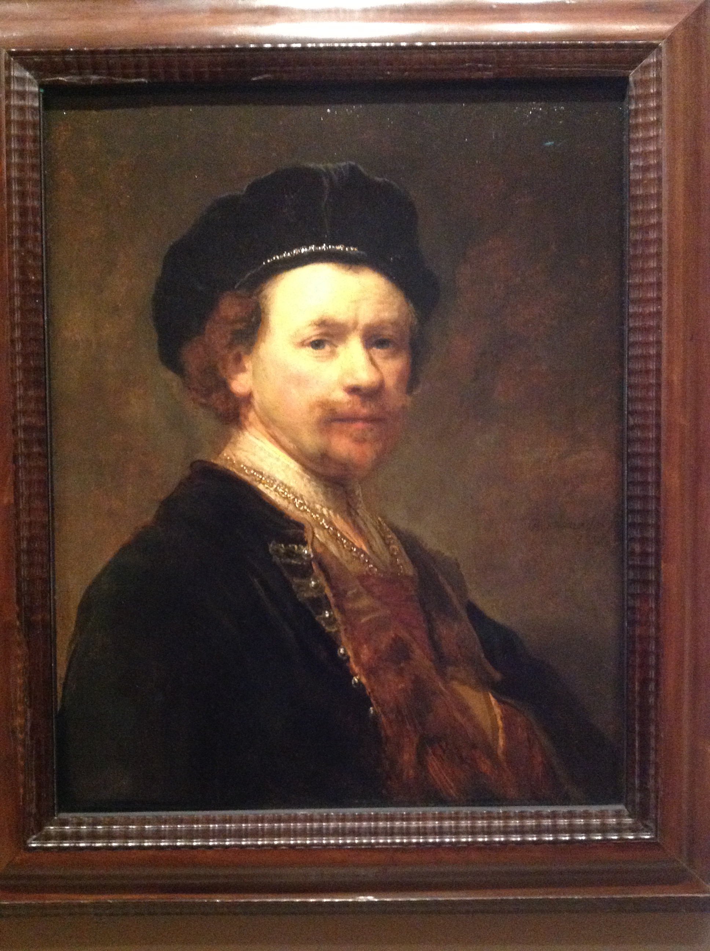
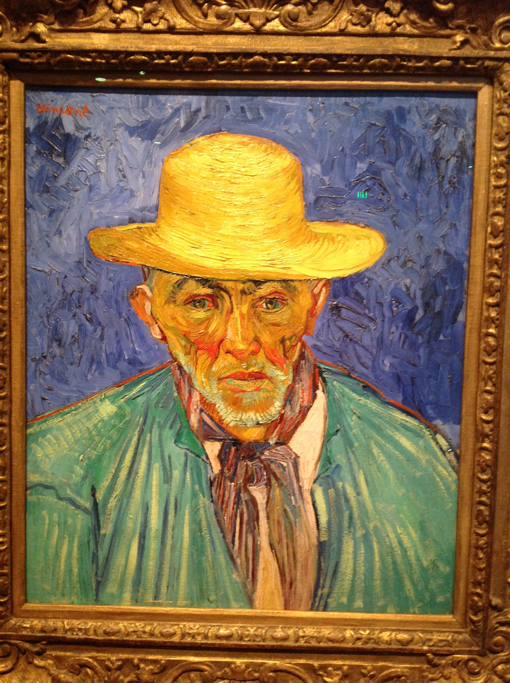
Cte field trip Degas
Rembrandt Gauguin
Van Gogh Picasso

Slide 7
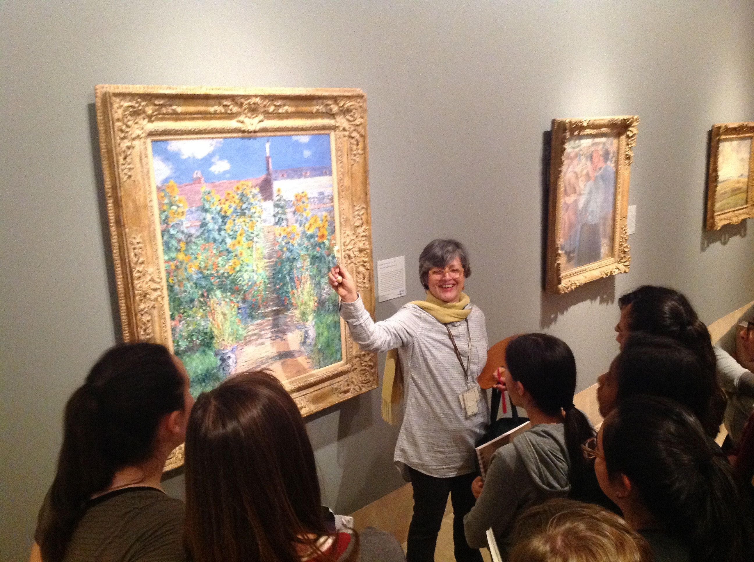
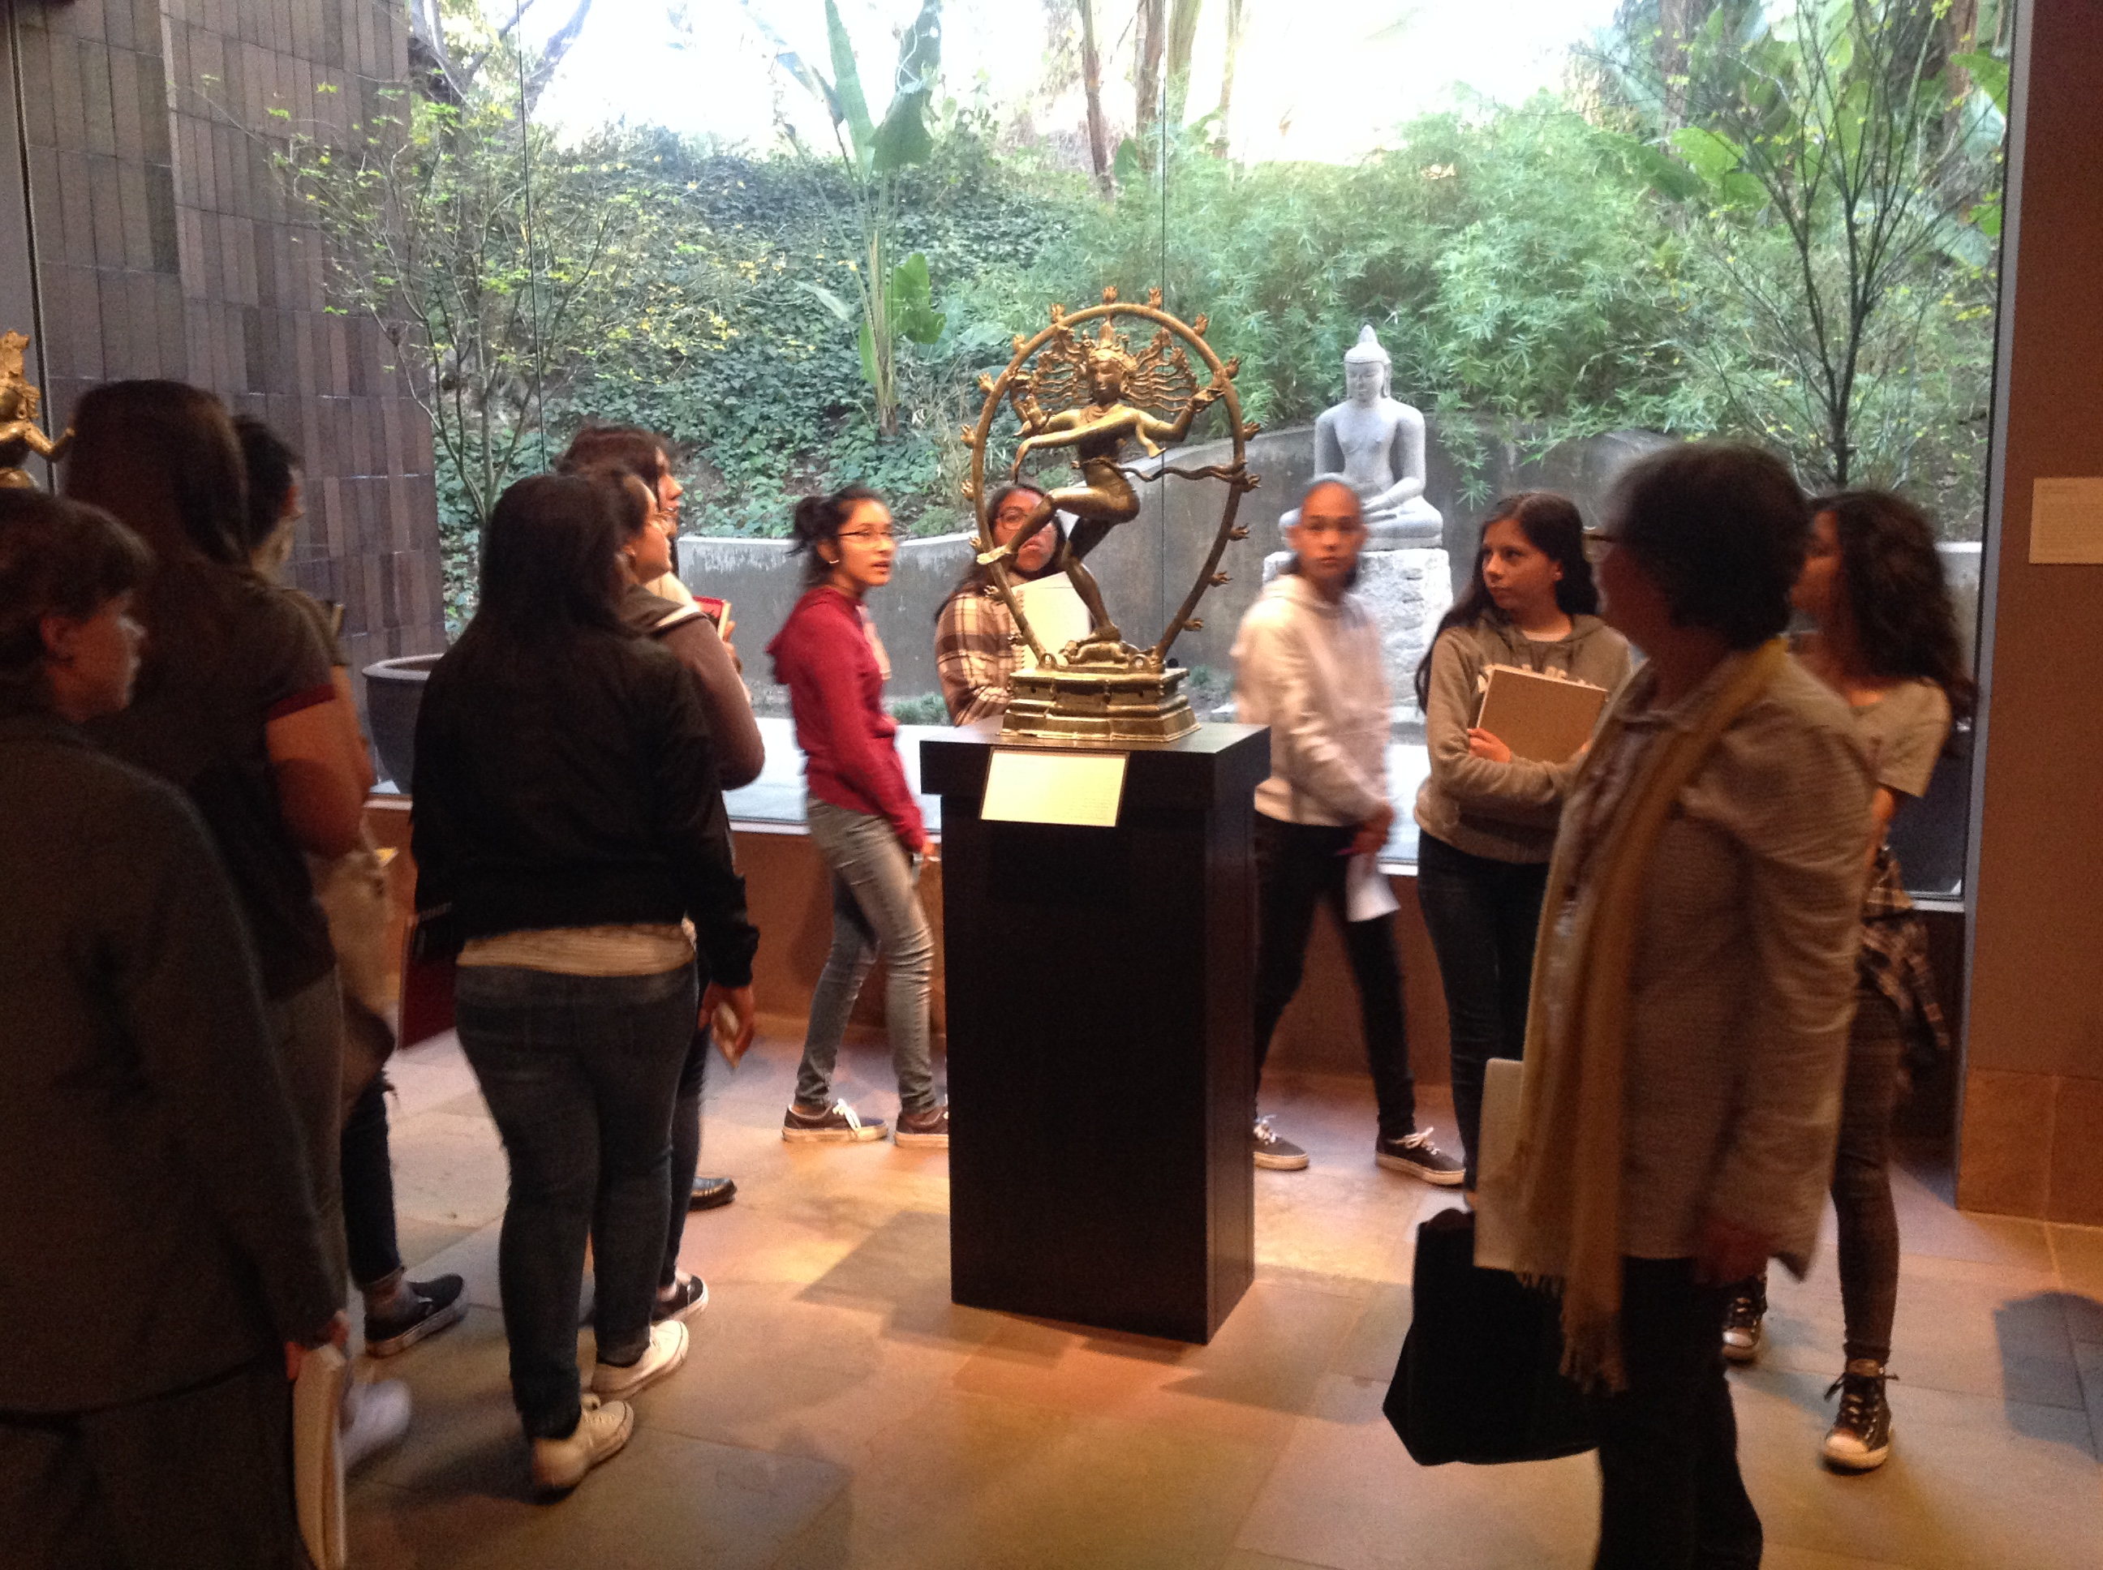
CTE field trip Learning about different cultures

Slide 8
Cte field trip art center
The CTE Visual Art students get a rare chance to visit one of the top art colleges in the industry.

Slide 9
Cte field trip
Internships: Adidas, Audie, BMW, Bugatti, CBS, Chrysler, Conan, Disney, DreamWorks, Facebook, Ford Motors, General Motors, Hasbro, Hewlett-Packard, Honda, IBM, ICON Aircraft, Jet Propulsion Lab, Mercedes-Benz Research, Microsoft, Nike, Nissan Design, Oakley, Pixar, Porsche, Samsung, Tesla Motors, Volkswagen Design, and more.

Slide 10
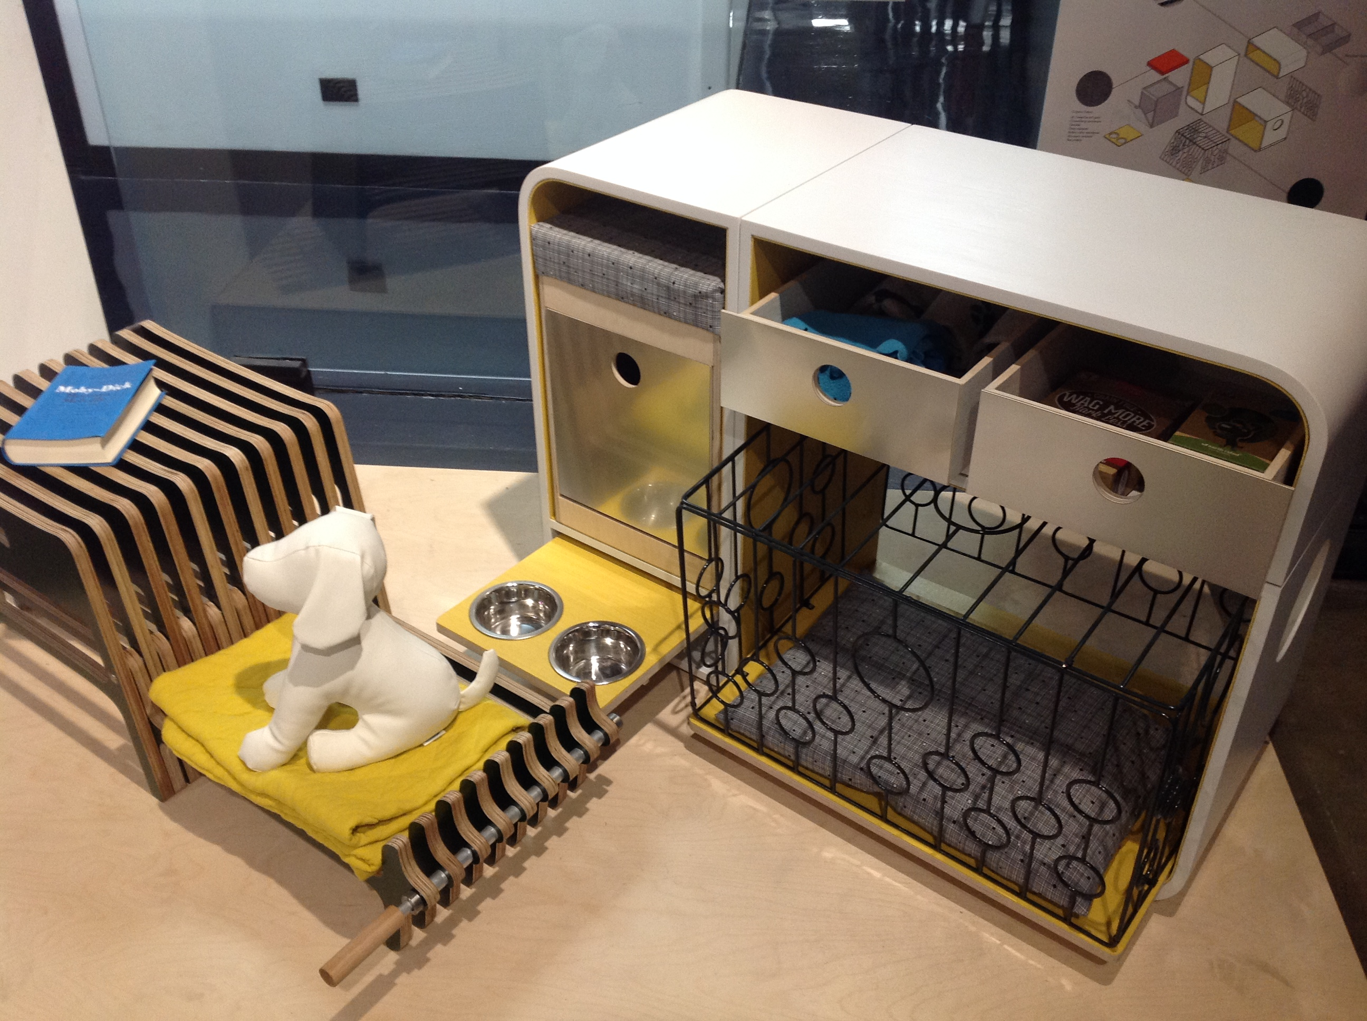
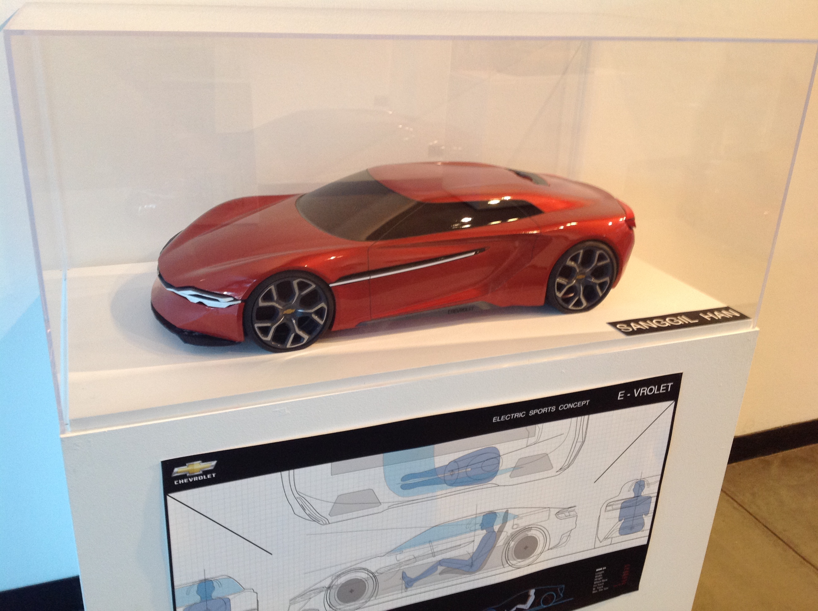
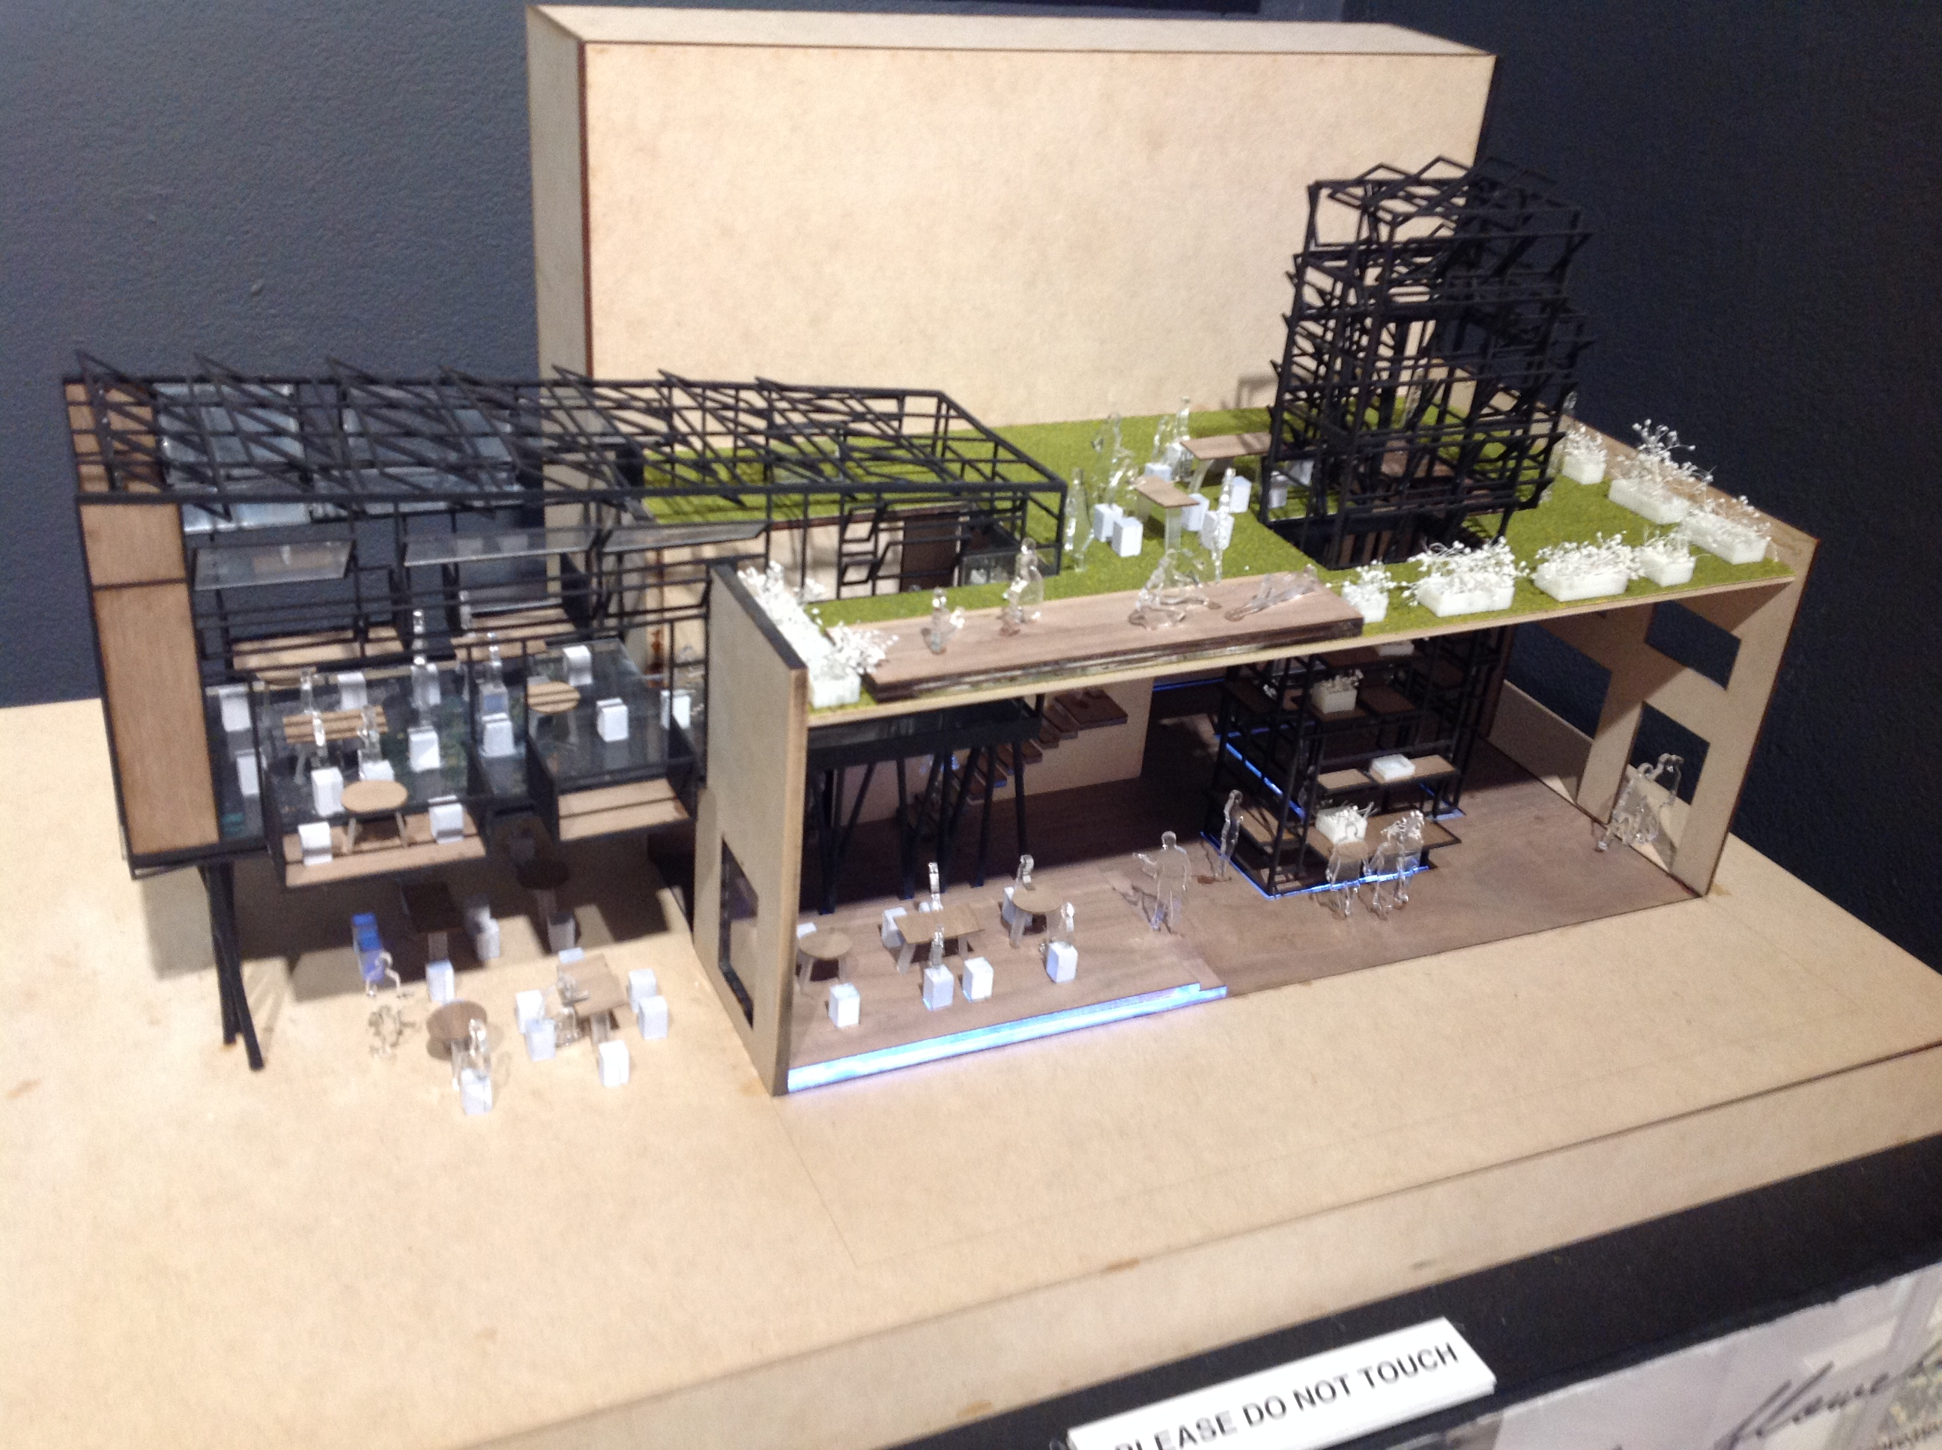
Cte field trip art center College of Design

Slide 11
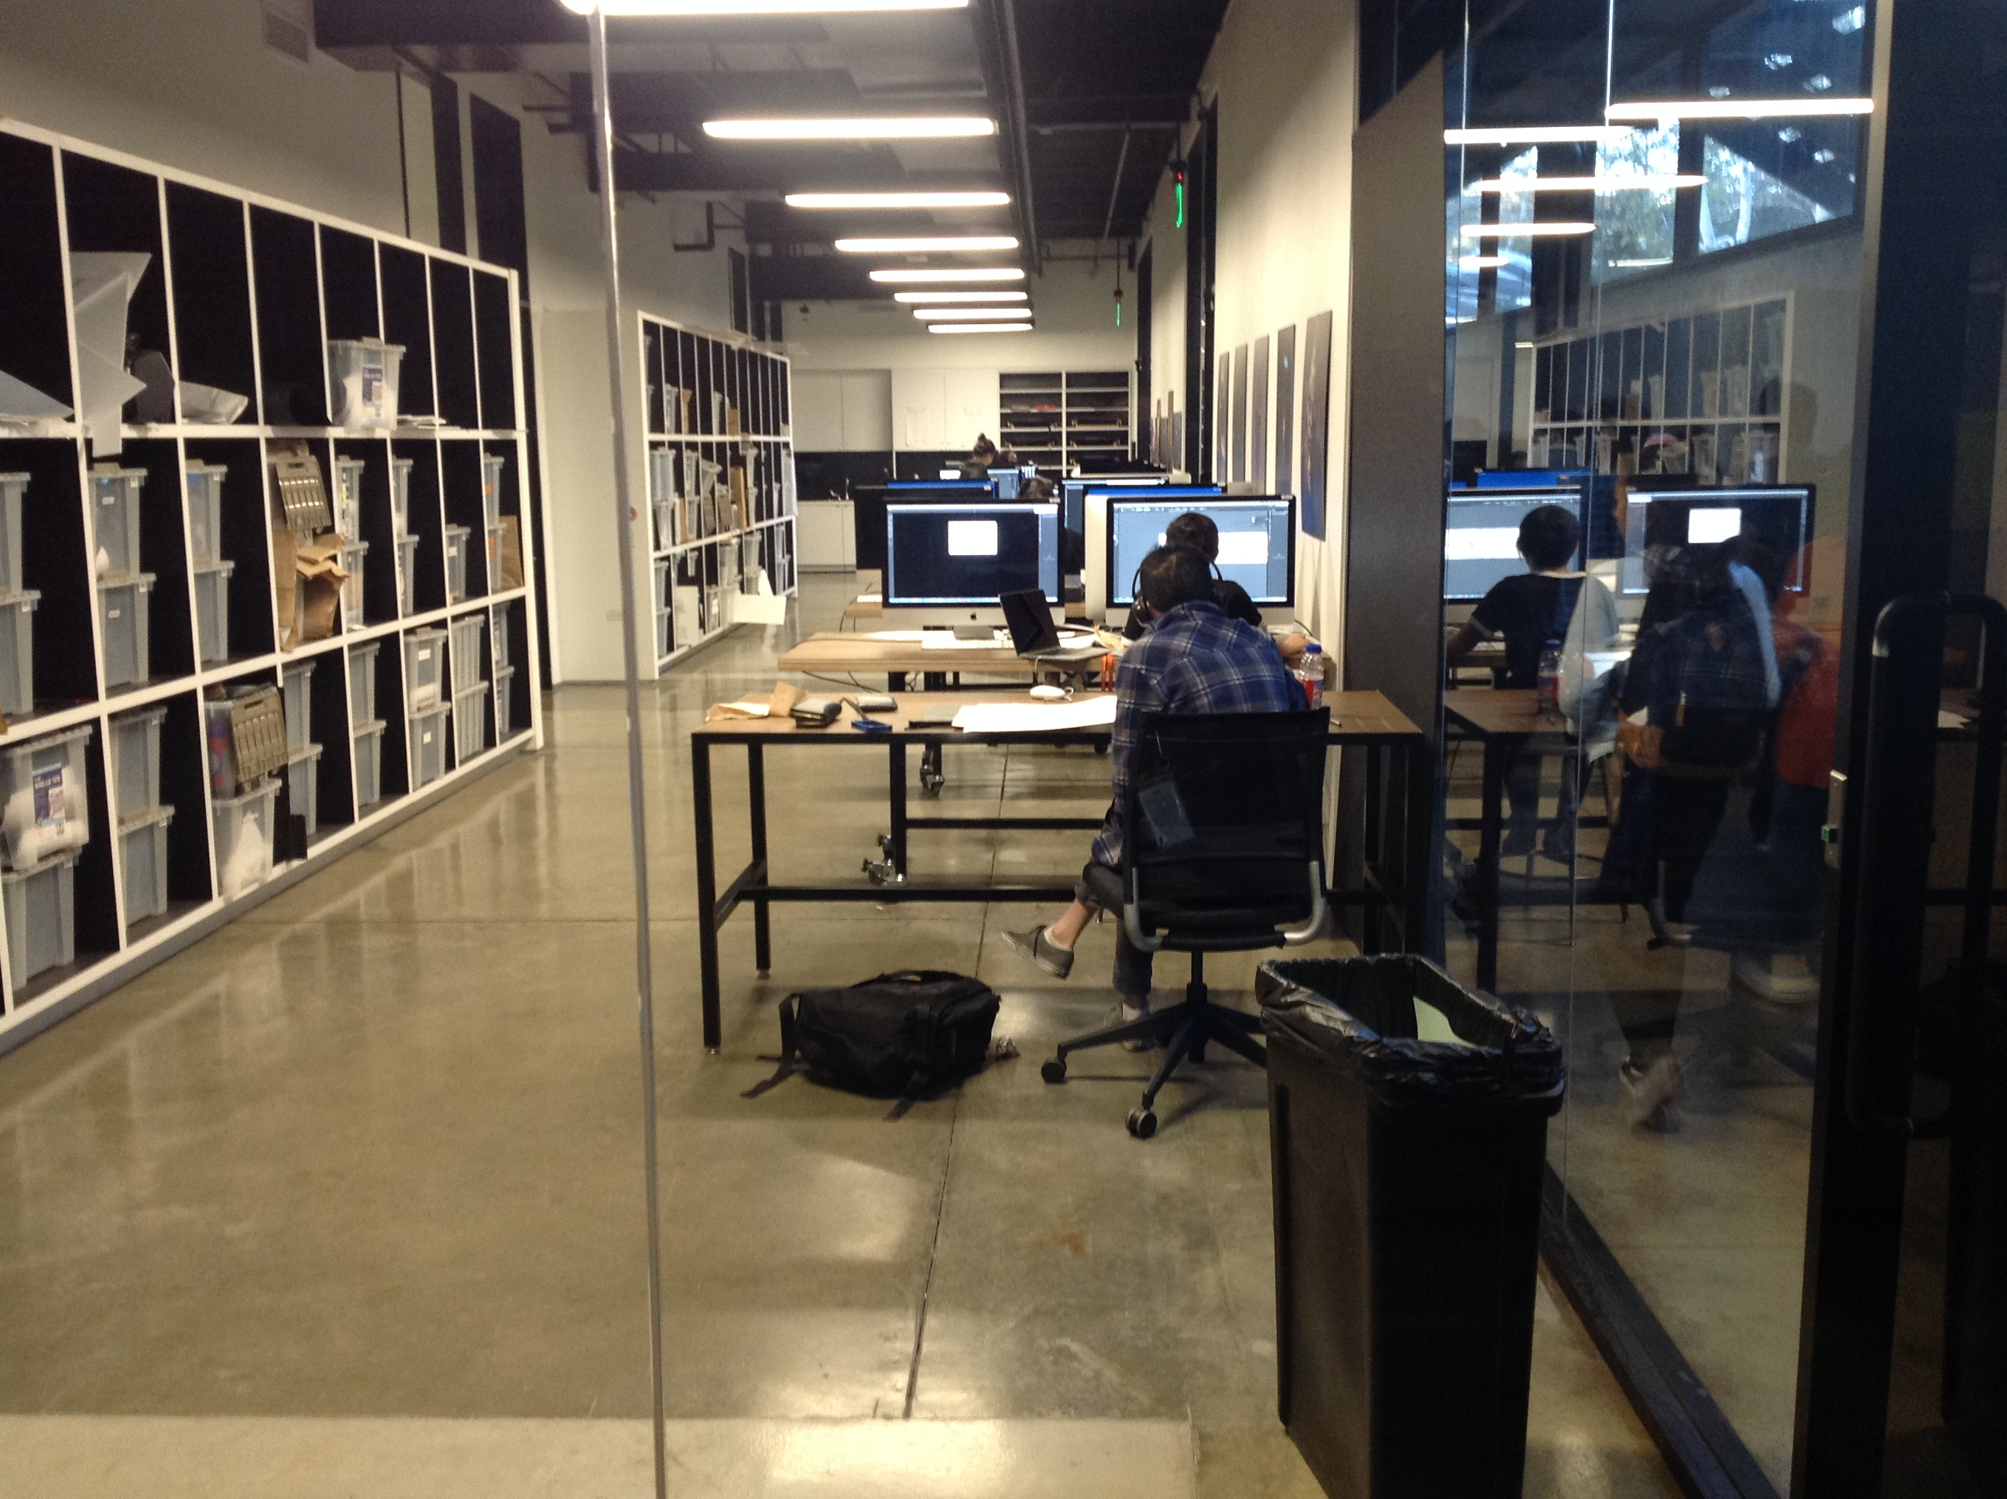
Cte field trip
The CTE students got an opportunity to see college students using state of the art industry machinery and technology.

Slide 12
Cte field trip

Slide 13
Cte field trip

Slide 14
Cte Field Trip
CTE Visual Art students heading back to Chula Vista High with an idea of a future career.

Slide 15
Cte field trip to Pasadena November 30, 2016
A special thanks to: Elaine Elefante-Leano, Director of College and Career Readiness,
Sweetwater Union High School District
From: CHULA VISTA HIGH SCHOOL/School of Creative and Performing Arts

